Slide 1

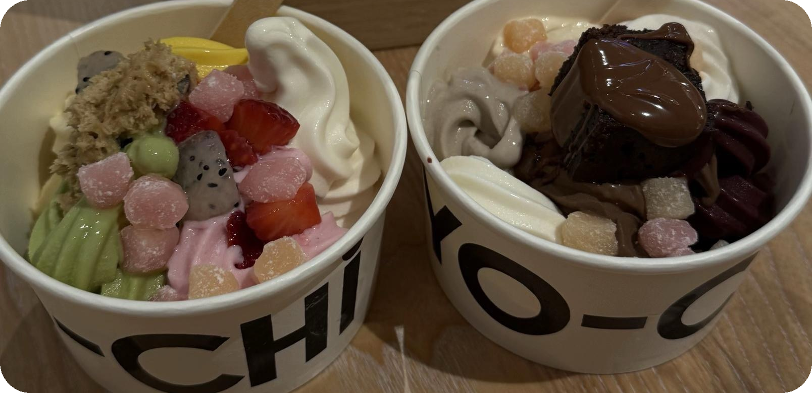
Yo-Chi Bowl Planner
Know your bowl's calories, sugar and cost before it hits the scale.
Fabiha Anbar
Notes:
Introduce yourself and the project. Before the slides, run the .txt script in PostgreSQL to show it builds all the tables and data without errors.

Slide 2
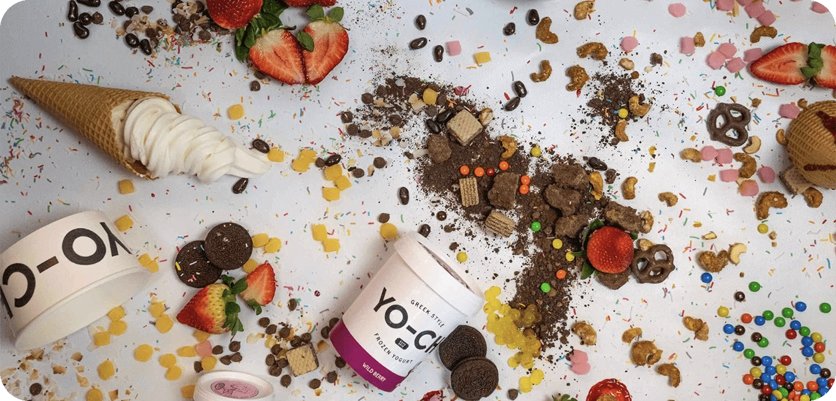
Why a Yo-Chi bowl needs a database
1
Fill your own cup
Any flavours and toppings, paid by weight.
2
Totals are hidden
Nutrition is listed per 100g, item by item.
8 flavours
11 toppings
6 saved bowls
3
This database adds it up
Every bowl's calories, sugar and cost, against your own limits.
Nutrition: yochi.com.au (kJ converted to kcal). Prices are illustrative.
Website : https://yochi.com.au/wp-content/uploads/2026/03/Nutritional-Information.pdf
Notes:
Yo-Chi is a self-serve frozen yogurt store in Australia: you fill a cup and pay by weight. Yo-Chi publishes calories and sugar per 100g for each item separately, so nobody tells you the total for the bowl you actually build. This database stores the flavours and toppings, saves customers' bowls with the grams of each item, and works out each bowl's calories, sugar and cost against the customer's calorie limit and budget (per bowl).

Slide 3
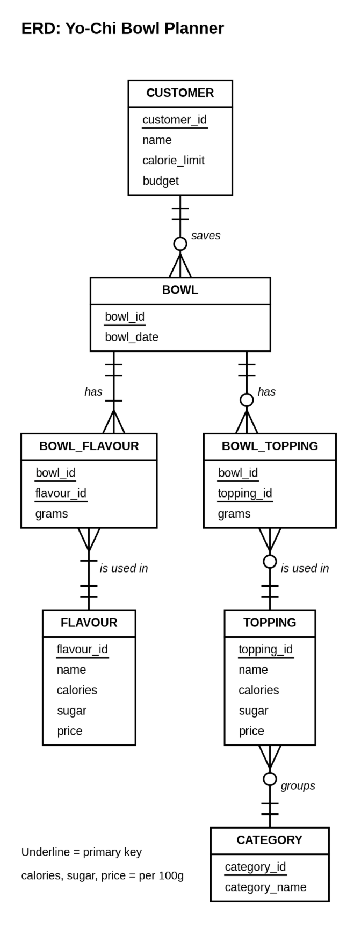
Entity Relationship Diagram
7 entities
Customer, Bowl, Flavour, Topping, Category + 2 bridge tables
2 one-to-many
Customer saves Bowls | Category groups Toppings
2 many-to-many
Bowl and Flavour | Bowl and Topping, each via a bridge table
Crow's foot notation
Keys underlined | values are per 100g
Notes:
Walk the diagram top to bottom: a customer saves zero or many bowls; each bowl has one or more flavours and zero or more toppings, stored with the grams used; toppings belong to a category. The two many-to-many relationships are already broken into bridge tables. For page 1 of the submission, paste the original ERD image so it fills an A4 page.

Slide 4
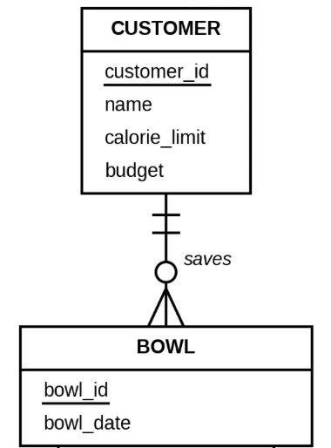
One-to-many: a customer saves bowls
1 : M
Customer
Bowl
customer_id | name | calorie_limit | budget
1 | Mia Chen | 450 | 12.00
2 | Liam Patel | 650 | 16.00
3 | Zara Ahmed | 350 | 10.00
4 | Noah Kim | 500 | 14.00
bowl_id | bowl_date | customer_id
101 | 2026-09-05 | 1
102 | 2026-09-19 | 1
103 | 2026-10-03 | 1
104 | 2026-09-12 | 2
105 | 2026-10-01 | 2
106 | 2026-09-27 | 3
Foreign key: customer_id in Bowl
Mia: 3 bowls | Noah: 0 bowls (optional)
Notes:
This 1:M is not part of a many-to-many. Mia's three bowls show the many side; Noah has none, which is what the circle on the Bowl end means. The foreign key has the same name as the primary key it references, which is why NATURAL JOIN works between these tables.

Slide 5
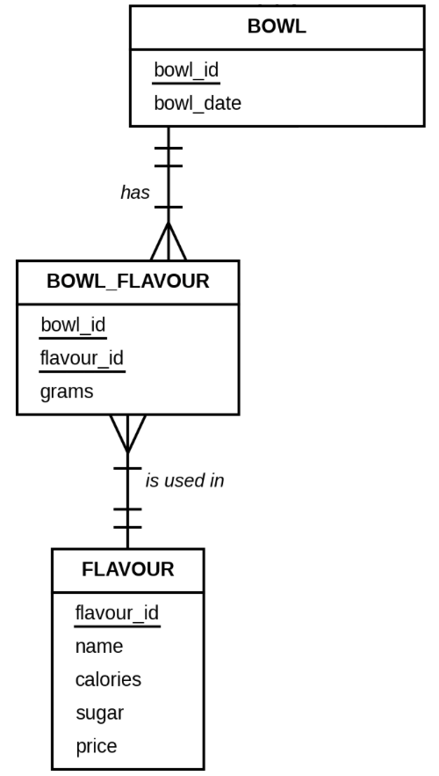
Many-to-many: bowls and flavours
M : M
Bowl
Bowl_Flavour (bridge)
Flavour
bowl_id | bowl_date
101 | 2026-09-05
106 | 2026-09-27
bowl_id | flavour_id | grams
101 | 1 | 150
101 | 5 | 100
106 | 5 | 220
flavour_id | name
1 | Vanilla
5 | Signature Tart
Bowl 101 has 2 flavours
Signature Tart is in 2 bowls
Bridge table key: (bowl_id, flavour_id)
One bowl, many flavours.
One flavour, many bowls.
Notes:
A bowl can have many flavours and a flavour can be in many bowls, so the M:M is broken into two 1:M relationships through Bowl_Flavour. Its primary key is both foreign keys together, and it also stores grams. Bowl and Topping work the same way through Bowl_Topping.

Slide 6
Query 1: Lightest flavours
6a Single table
Which flavours have fewer than 125 kcal per 100g?
SQL
SELECT name, calories, sugar
FROM Flavour
WHERE calories < 125
ORDER BY calories;
OUTPUT
name | calories | sugar
----------------+----------+-------
Ube | 118 | 20.7
Vanilla | 123 | 21.4
Signature Tart | 124 | 20.9
(3 rows)
Lightest bases: Ube, Vanilla and Signature Tart.
Notes:
A simple query on one table: project three columns, restrict with WHERE, sort with ORDER BY.

Slide 7
Query 2: What each topping adds
6b NATURAL JOIN
How many calories does each topping add to bowl 104?
SQL
SELECT name, grams, ROUND(grams * calories / 100.0, 1) AS calories_added
FROM Bowl_Topping NATURAL JOIN Topping
WHERE bowl_id = 104
ORDER BY calories_added DESC;
OUTPUT
name | grams | calories_added
----------------+-------+----------------
Nutella (Warm) | 40 | 215.2
Almonds | 25 | 142.5
Mini Mochi | 40 | 140.4
(3 rows)
Nutella adds the most: 215 kcal.
Notes:
NATURAL JOIN matches the two tables on topping_id, the only column name they share. grams x calories / 100.0 gives the calories added; 100.0 avoids integer division.

Slide 8
Query 3: Same query, cross product
6c Cross product
Query 2 rewritten with both tables in FROM and the join in WHERE.
SQL
SELECT name, grams, ROUND(grams * calories / 100.0, 1) AS calories_added
FROM Bowl_Topping, Topping
WHERE Bowl_Topping.topping_id = Topping.topping_id
AND bowl_id = 104
ORDER BY calories_added DESC;
OUTPUT
name | grams | calories_added
----------------+-------+----------------
Nutella (Warm) | 40 | 215.2
Almonds | 25 | 142.5
Mini Mochi | 40 | 140.4
(3 rows)
Identical 3 rows to Query 2.
Notes:
The join condition Bowl_Topping.topping_id = Topping.topping_id is written by hand. topping_id needs the table name because it is in both tables.

Slide 9
Query 4: Heavy topping categories
6d GROUP BY / HAVING
Which topping categories average more than 300 kcal per 100g?
SQL
SELECT category_name, COUNT(*) AS toppings, ROUND(AVG(calories), 1) AS avg_calories
FROM Topping NATURAL JOIN Category
GROUP BY category_name
HAVING AVG(calories) > 300
ORDER BY avg_calories DESC;
OUTPUT
category_name | toppings | avg_calories
------------------+----------+--------------
Crunch | 2 | 572.0
Sweet Treats | 3 | 429.3
Sauces & Spreads | 3 | 409.0
(3 rows)
Fresh Fruit (44 kcal) is filtered out by HAVING.
Notes:
GROUP BY makes one row per category; HAVING filters the groups after averaging, because an aggregate cannot go in WHERE.

Slide 10
Query 5: Sugariest toppings
6e Sub-query
Which toppings have more sugar than the average topping?
SQL
SELECT name, sugar
FROM Topping
WHERE sugar > (SELECT AVG(sugar)
FROM Topping)
ORDER BY sugar DESC;
OUTPUT
name | sugar
-------------------------+-------
Nutella (Warm) | 56.3
Chocolate Fudge Brownie | 38.2
Oreos | 38.0
Biscoff Spread | 36.8
Mini Mochi | 27.9
(5 rows)
5 of 11 toppings beat the 23.7g average.
Notes:
The sub-query (SELECT AVG(sugar) FROM Topping) runs first and returns one number; the outer query compares every topping against it. It is not correlated.

Slide 11
Query 6: Healthier swaps
6f Self join
Which same-category swap saves at least 400 kcal per 100g?
SQL
SELECT t1.name AS topping, t2.name AS healthier_swap,
t1.calories - t2.calories AS calories_saved
FROM Topping t1, Topping t2
WHERE t1.category_id = t2.category_id
AND t1.calories - t2.calories >= 400
ORDER BY t1.name;
OUTPUT
topping | healthier_swap | calories_saved
----------------+------------------+----------------
Biscoff Spread | Raspberry Coulis | 479
Nutella (Warm) | Raspberry Coulis | 433
(2 rows)
Swap Nutella or Biscoff for Raspberry Coulis.
Notes:
This cannot be a NATURAL JOIN: Topping is joined to itself as t1 and t2, matched on category_id but compared on calories.

Slide 12
CHECK constraints keep the data real
19 CHECKs
Range
Two columns
CHECK ((sugar >= 0) AND (sugar <= 100))
CHECK (calories >= sugar * 4)
No more sugar than food.
1g of sugar = about 4 kcal.
Allowed values
Amounts
CHECK (category_name IN (...))
CHECK ((grams > 0) AND (grams <= 1000))
Only real categories.
No empty or giant scoops.
Notes:
Show a variety: a range check, a check comparing two columns, a list of allowed values, and realistic amounts. calories >= sugar x 4 is the most interesting: each gram of sugar gives about 4 kcal, so a food can never have fewer calories than its sugar provides. There are also checks on customer limits, prices, IDs and dates - 19 in total.

Slide 13
ON DELETE: protect or clean up
Referential integrity
ON DELETE RESTRICT
ON DELETE CASCADE
CONSTRAINT Bowl_FlavourFK_Flavour
FOREIGN KEY (flavour_id)
REFERENCES Flavour
ON DELETE RESTRICT
CONSTRAINT BowlFK_Customer
FOREIGN KEY (customer_id)
REFERENCES Customer
ON DELETE CASCADE
TRY IT
TRY IT
DELETE FROM Flavour WHERE flavour_id = 1;
DELETE FROM Customer WHERE customer_id = 1;
ERROR: Vanilla is still in bowl 101
Mia's 3 bowls are deleted too
Notes:
RESTRICT protects data other rows depend on: flavours, toppings and categories in use can't be deleted (real error: violates foreign key constraint bowl_flavourfk_flavour). CASCADE removes data that only makes sense with its parent: deleting Mia removes her 3 bowls and their flavour and topping rows (Bowl 6 -> 3 rows, Bowl_Flavour 9 -> 5). In the script these DELETEs are comments so running it doesn't change the data.

Slide 14

The view: Bowl_Summary
CREATE VIEW
1
Add up the flavours
grams x value / 100, per bowl
CREATE VIEW Bowl_Summary AS
SELECT b.bowl_id, c.name AS customer,
... AS total_calories, ... AS total_cost,
CASE WHEN ... <= c.calorie_limit
THEN 'Yes' ELSE 'No' END AS within_calories,
CASE WHEN ... <= c.budget
THEN 'Yes' ELSE 'No' END AS within_budget
FROM Bowl b JOIN Customer c ON ...
JOIN (flavour totals per bowl) f ON ...
LEFT JOIN (topping totals per bowl) t ON ...;
2
Add up the toppings
LEFT JOIN: toppings are optional
3
Compare with limits
Yes / No for calories and budget
Shortened - full SQL is in the script.
Notes:
Flavours and toppings are summed separately in two sub-queries and then added, so a bowl with several flavours and several toppings isn't double counted. LEFT JOIN keeps bowl 106, which has no toppings, and COALESCE turns its missing topping total into 0. CASE compares the totals with the customer's calorie_limit and budget.

Slide 15
The view in use
SELECT from view
Every bowl: totals and whether it fits
SELECT bowl_id, customer, total_calories, total_cost, within_calories, within_budget
FROM Bowl_Summary
ORDER BY bowl_id;
bowl_id | customer | total_calories | total_cost | within_calories | within_budget
---------+------------+----------------+------------+-----------------+---------------
101 | Mia Chen | 333.7 | 12.99 | Yes | No
102 | Mia Chen | 587.8 | 11.88 | No | Yes
103 | Mia Chen | 291.9 | 10.70 | Yes | Yes
104 | Liam Patel | 952.1 | 18.15 | No | No
105 | Liam Patel | 587.5 | 13.56 | Yes | Yes
106 | Zara Ahmed | 272.8 | 8.58 | Yes | Yes
(6 rows)
Bowls within BOTH limits
SELECT bowl_id, customer, total_calories, total_cost
FROM Bowl_Summary
WHERE within_calories = 'Yes' AND within_budget = 'Yes'
ORDER BY bowl_id;
bowl_id | customer | total_calories | total_cost
---------+------------+----------------+------------
103 | Mia Chen | 291.9 | 10.70
105 | Liam Patel | 587.5 | 13.56
106 | Zara Ahmed | 272.8 | 8.58
(3 rows)
Notes:
The view hides all the maths: a simple SELECT now answers 'does this bowl fit my limits?'. Bowls 103, 105 and 106 fit both the calorie limit and the budget.

Slide 16

Chocolate bowl under $20?
Bonus: plan a bowl
350g Choccy + 50g fruit + 50g chocolate topping: what does it cost?
SQL
SELECT t1.name AS fruit, t2.name AS chocolate_topping,
ROUND((350*f.price + 50*t1.price + 50*t2.price)/100.0, 2) AS total_cost,
CASE WHEN (350*f.price + 50*t1.price + 50*t2.price)/100.0 < 20
THEN 'Yes' ELSE 'No' END AS under_20
FROM Flavour f, Topping t1, Topping t2
WHERE f.name = 'Choccy (VF)'
AND t1.category_id = 1
AND t2.name IN ('Oreos', 'Chocolate Fudge Brownie', 'Nutella (Warm)', 'Biscoff Spread')
ORDER BY total_cost;
OUTPUT
fruit | chocolate_topping | total_cost | under_20
-------------------+-------------------------+------------+----------
Strawberries | Nutella (Warm) | 19.80 | Yes
Fresh Mango | Nutella (Warm) | 19.85 | Yes
Strawberries | Oreos | 19.90 | Yes
Strawberries | Biscoff Spread | 19.90 | Yes
Fresh Mango | Biscoff Spread | 19.95 | Yes
Fresh Mango | Oreos | 19.95 | Yes
Fresh Blueberries | Nutella (Warm) | 19.95 | Yes
Strawberries | Chocolate Fudge Brownie | 19.95 | Yes
Fresh Mango | Chocolate Fudge Brownie | 20.00 | No
Fresh Blueberries | Oreos | 20.05 | No
Fresh Blueberries | Biscoff Spread | 20.05 | No
Fresh Blueberries | Chocolate Fudge Brownie | 20.10 | No
(12 rows)
Strawberries keep every combo under $20.
Notes:
Planning queries combine every flavour with every topping (a cross product) using portion sizes written into the query. Topping is used twice (t1 and t2), so this is also a self join. With blueberries, only Nutella stays under $20. Costs depend on the illustrative prices.

Slide 17
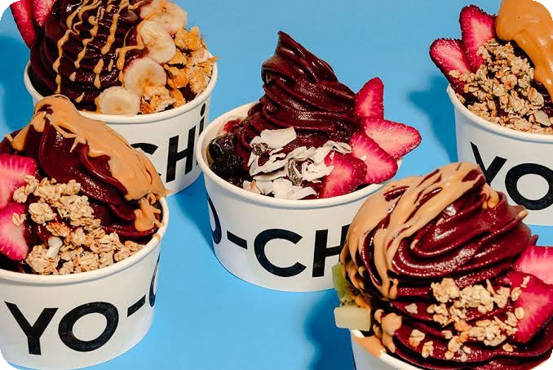
Under 200 calories?
Bonus: plan a bowl
150g of yogurt + 30g of one topping: which combos are under 200 kcal?
SQL
SELECT f.name AS flavour, t.name AS topping,
ROUND((150*f.calories + 30*t.calories)/100.0, 1) AS calories,
ROUND((150*f.price + 30*t.price)/100.0, 2) AS cost
FROM Flavour f, Topping t
WHERE (150*f.calories + 30*t.calories)/100.0 < 200
ORDER BY calories;
OUTPUT
flavour | topping | calories | cost
----------------+-------------------+----------+------
Ube | Strawberries | 186.9 | 7.65
Ube | Fresh Blueberries | 189.0 | 7.74
Vanilla | Strawberries | 194.4 | 7.20
Ube | Fresh Mango | 195.0 | 7.68
Signature Tart | Strawberries | 195.9 | 7.20
Vanilla | Fresh Blueberries | 196.5 | 7.29
Signature Tart | Fresh Blueberries | 198.0 | 7.29
(7 rows)
Only fruit toppings make the cut.
Notes:
Only 7 combinations fit, all Ube, Vanilla or Signature Tart with fresh fruit.

Slide 18
Treat bowls: 200-300 kcal, under $12
Bonus: plan a bowl
150g of yogurt + 25g of a Sweet Treat: what fits?
SQL
SELECT f.name AS flavour, t.name AS topping,
ROUND((150*f.calories + 25*t.calories)/100.0, 1) AS calories,
ROUND((150*f.price + 25*t.price)/100.0, 2) AS cost
FROM Flavour f, Topping t, Category c
WHERE t.category_id = c.category_id
AND c.category_name = 'Sweet Treats'
AND (150*f.calories + 25*t.calories)/100.0 BETWEEN 200 AND 300
AND (150*f.price + 25*t.price)/100.0 < 12
ORDER BY calories;
OUTPUT
flavour | topping | calories | cost
---------------------+-------------------------+----------+------
Ube | Mini Mochi | 264.8 | 7.68
Vanilla | Mini Mochi | 272.3 | 7.23
Signature Tart | Mini Mochi | 273.8 | 7.23
Mango | Mini Mochi | 279.8 | 7.23
Matcha | Mini Mochi | 279.8 | 7.68
Salted Butterscotch | Mini Mochi | 282.8 | 7.53
Cookies & Cream | Mini Mochi | 284.3 | 7.53
Ube | Chocolate Fudge Brownie | 288.8 | 7.63
Vanilla | Chocolate Fudge Brownie | 296.3 | 7.18
Signature Tart | Chocolate Fudge Brownie | 297.8 | 7.18
Ube | Oreos | 299.5 | 7.60
(11 rows)
Mochi, brownie, even Oreos fit.
Notes:
Joins Topping to Category to pick only Sweet Treats, then filters on the calculated calories and cost. 11 combinations fit.

Slide 19
Thank you!
Questions?
Fabiha Anbar
Photos: Yo-Chi and @yeetengng7 (Lemon8), Data: yochi.com.au
Notes:
Summarise: 7 tables, 19 CHECKs, RESTRICT and CASCADE, a view that does the bowl maths, and queries that answer real questions a Yo-Chi customer has.

